Slide 1
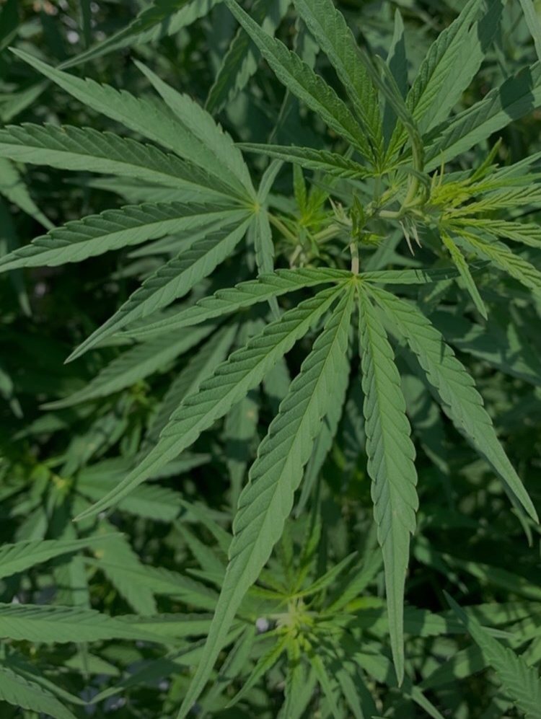
Influence of cadmium on plant growth and cannabinoid content in hydroponically-grown hemp
MASTPAWG Meeting 2023
Amanda Olbrick Marabesi
Dr. Timothy Coolong
Dr. Jason Lessl
Dr. Savithri Nambeesan
Dr. Marc van Iersel

Slide 2
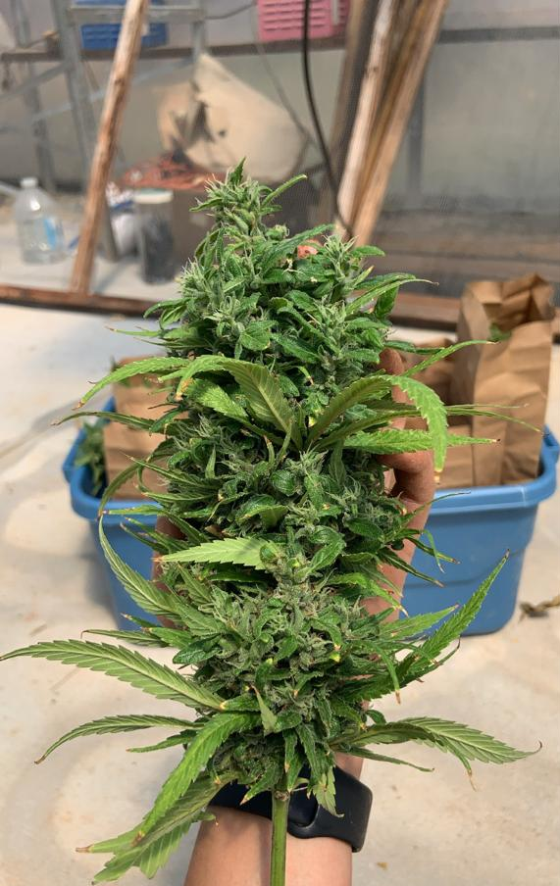
Hemp (Cannabis sativa L.)
Hemp = Industrial or medicinal use
For medicinal use: usually sold as biomass and smokable flower
Cannabinoids: cannabidiol (CBD) and tetrahydrocannabinol (THC, should be < 0.3% dw), among others
Although legalized by the U.S. federal government, there are significant regulations for industrial hemp production that must be followed to stay in compliance with the law.
Heavy metal concentrations in hemp biomass is an area of concern as products may be consumed as dietary supplements

Slide 3
Cadmium
Humans can be exposed to heavy metals via water, food, cosmetics, medicinal products, and smoking.
Cadmium (Cd) → has been associated with smoking tobacco (Cd hyperaccumulator)
Harmful effects of Cd inhalation include renal tubular dysfunction, osteomalacia, lung disease, and it is classified as a Group 1 carcinogen
Consumers are less likely to perceive the harms of cannabis smoke to the same extent as the harms caused by smoking tobacco.
Heavy metal testing in hemp is not federally enforced and there are inconsistencies with heavy metal limits in different states where hemp is grown and processed.

Slide 4
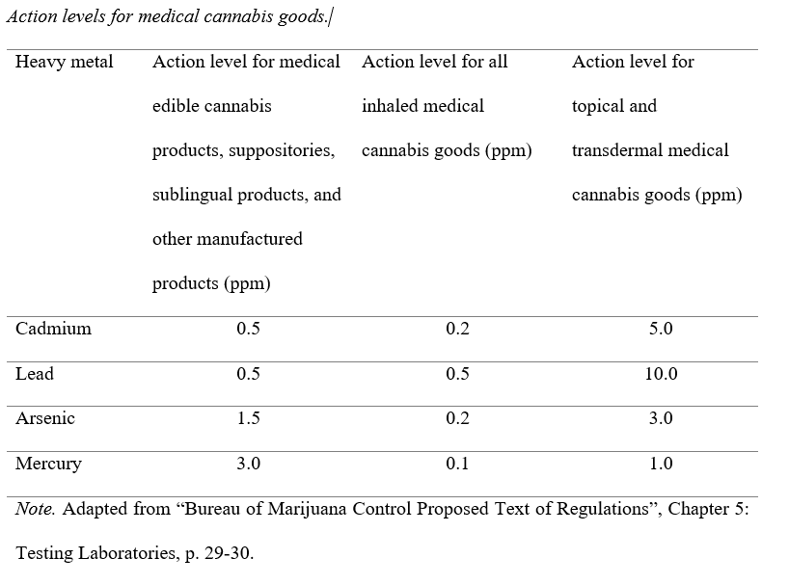
Table 1.

Slide 5
Heavy Metals in Agricultural Soils
Cd may also be introduced to agricultural soils via contaminated manure and biosolids, phosphate fertilizers, mine waste, atmospheric deposition from smelter emissions, and industrial waste
Although the potential harms to ecosystems and human and animal health caused by heavy metals have been thoroughly investigated, there are still inconsistencies regarding heavy metal thresholds for agricultural soils.
U.S. EPA has set no thresholds for total concentrations or bioavailable heavy metals in agricultural soils.

Slide 6
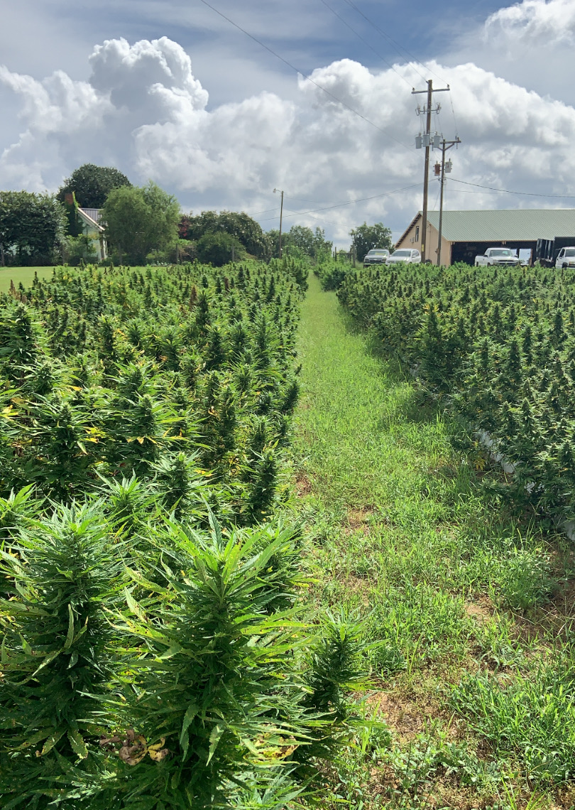
Need for Research
Hemp has agronomic traits that could facilitate accumulation of heavy metals: extensive and deep root system, efficient translocation of contaminants to the shoots, a rapid life cycle, and high biomass production.
However, there is a lack of research on metal accumulation by industrial hemp varieties destined for human consumption.

Slide 7
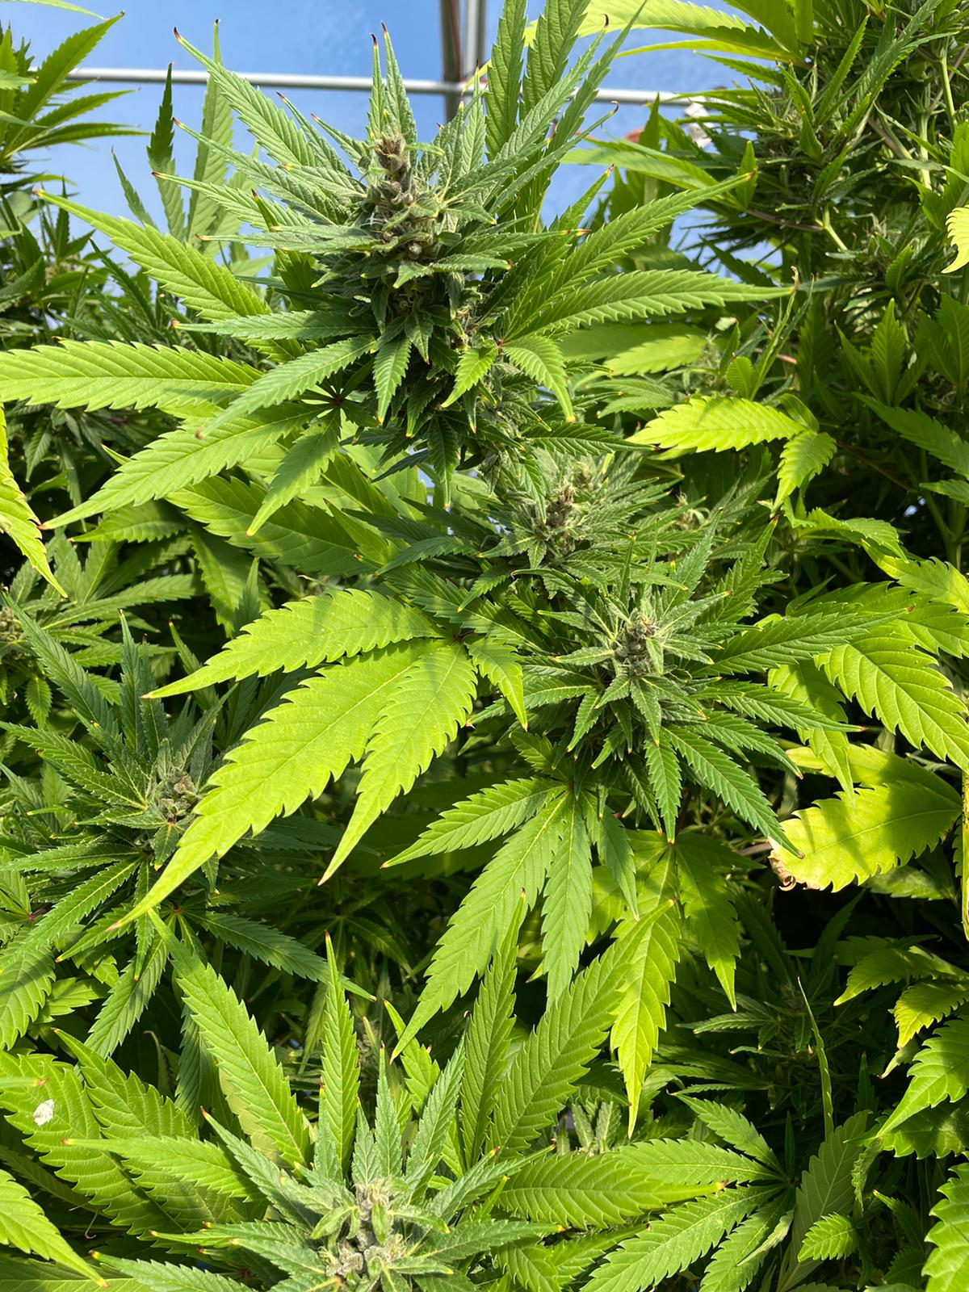
This study evaluated the accumulation of Cd by the industrial hemp variety “Purple Tiger”, grown for cannabinoid production, during two seasons (experiment 1 and experiment 2).
The plants were grown in deep water culture (DWC) systems containing a nutrient solution and a known concentration of Cd.
Treatments:
0 ppm (control)
2.5 ppm of Cd
10 ppm of Cd
25 ppm of Cd

Slide 8
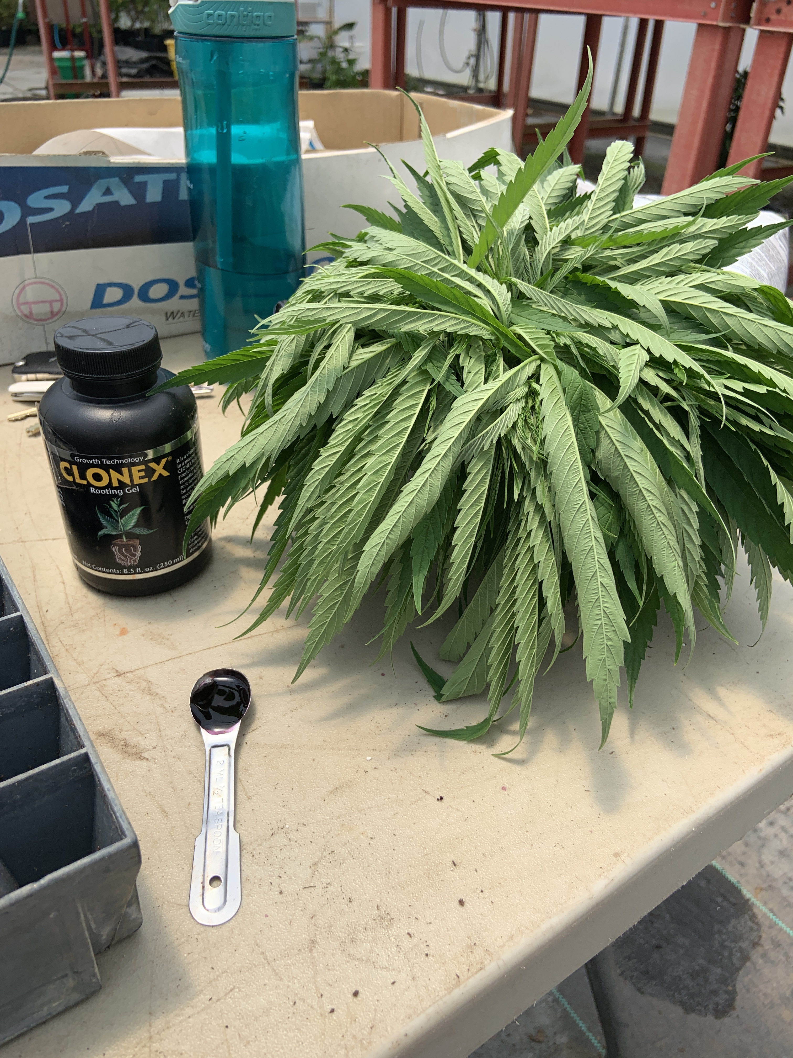
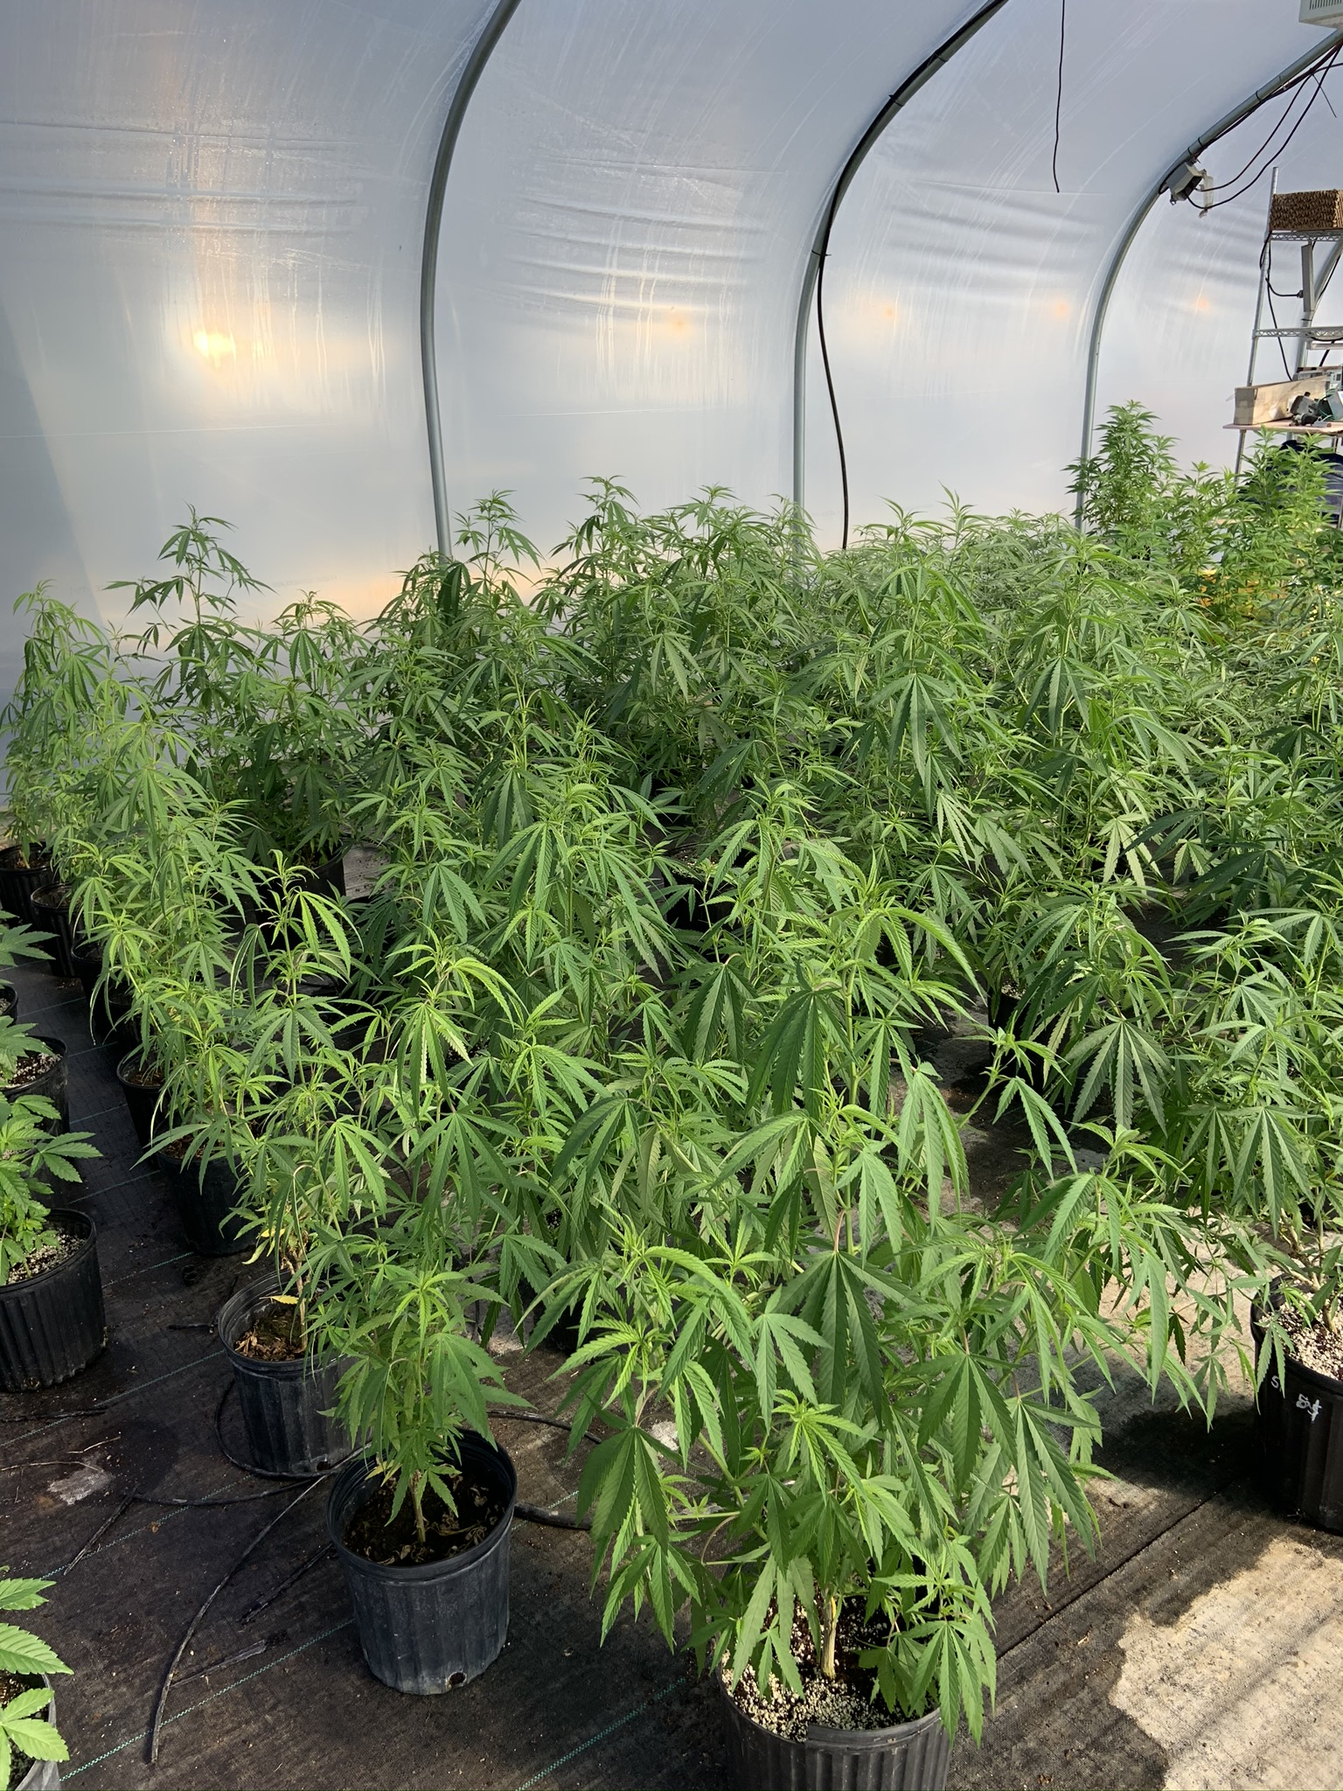
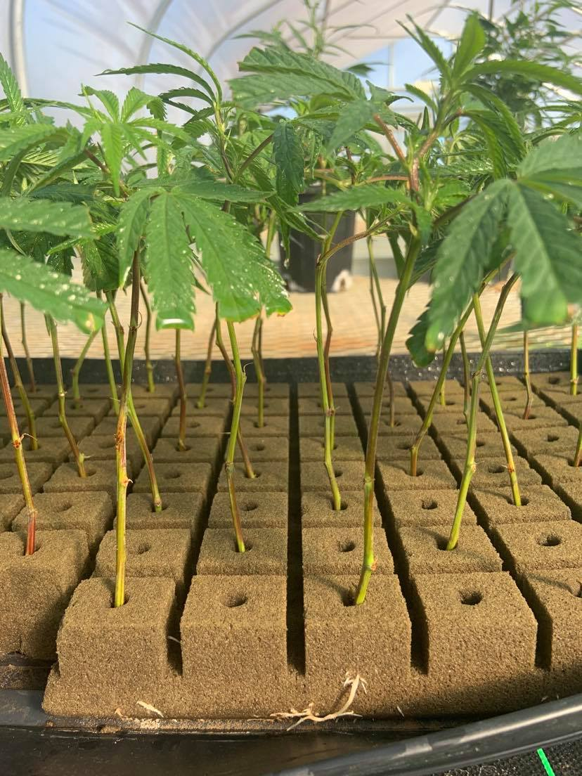
Propagation

Slide 9
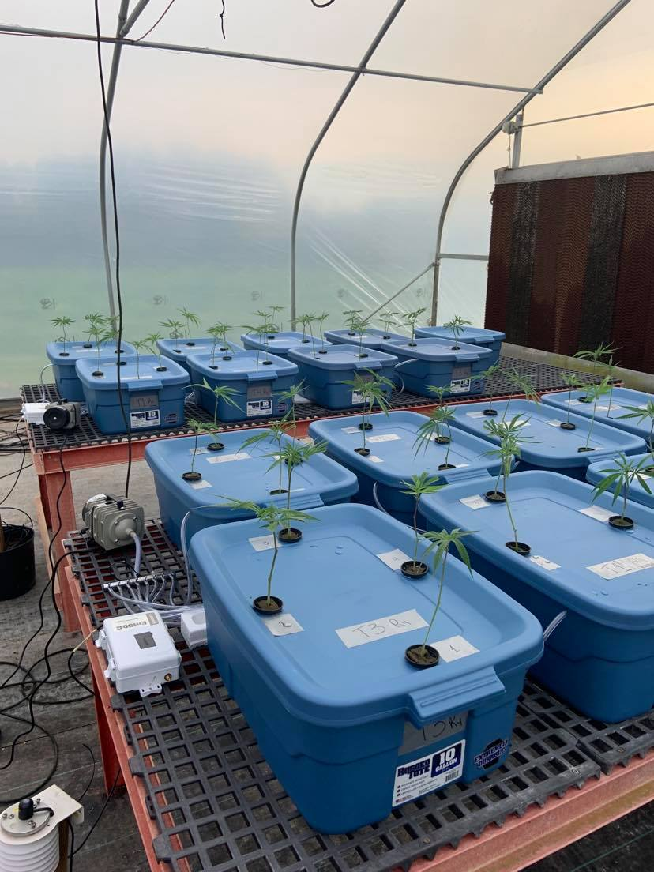
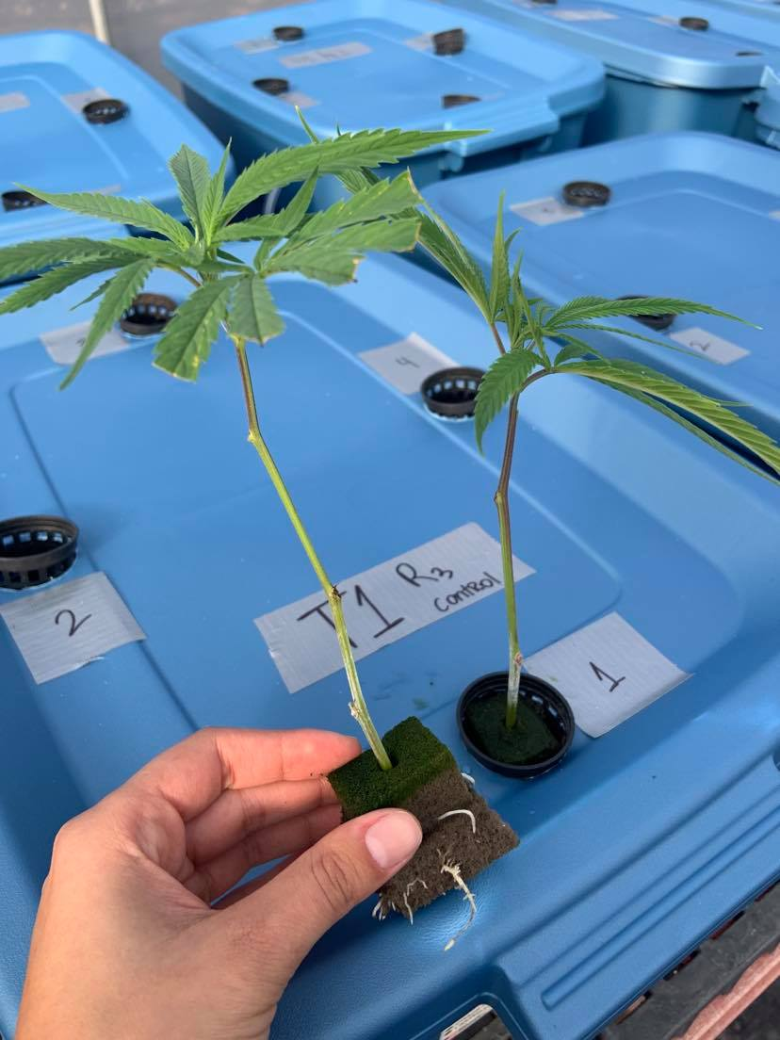
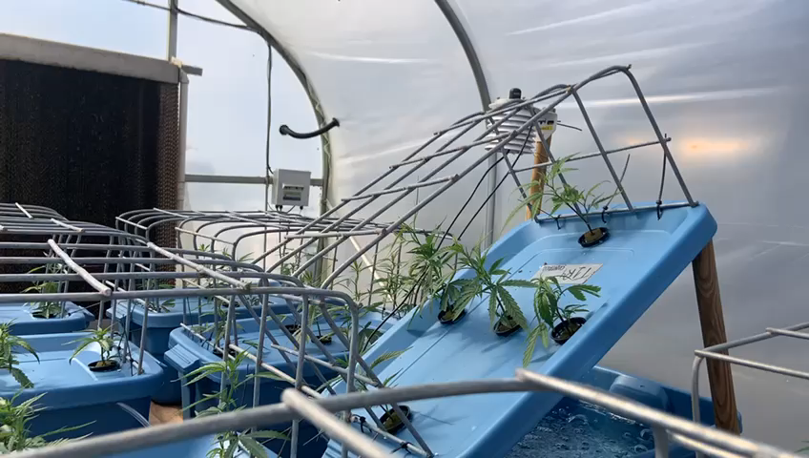
DWC system

Slide 10
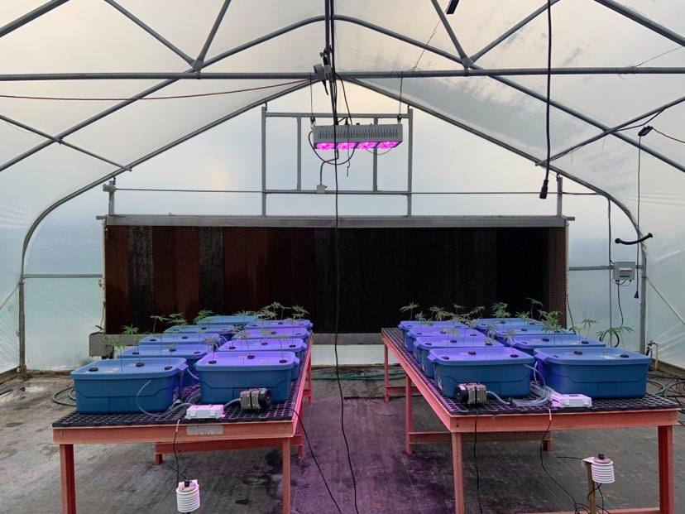
Supplemental light ~ 100 µmol/m²s
4 weeks of acclimation before starting Cd treatments

Slide 11
Materials & Methods
A new nutrient solution was prepared every 14 days, aiming 150 ppm N and solutions were analyzed at the beginning and end of every cycle
EC and pH of nutrient solutions were monitored weekly
Photosynthetic yield (MINI-PAM-II fluorometer, WALZ©) was measured after 14, 45, and 68 (harvest) days after exposure to Cd treatments (DAT)
Root, stem, leaf, and flower material were collected at harvest for dry biomass quantification, cannabinoid analysis (HPLC, SJ Labs and Analytics, Macon, GA), and metal content analysis (ICP-OES, UGA Soil, Plant & Water Laboratory, Athens, GA).
Statistical analysis was conducted using JMP Pro 15. Data were subjected to a one-way ANOVA procedure with Tukey’s honest significant difference test (p < 0.05) conducted for mean separation when appropriate.

Slide 12
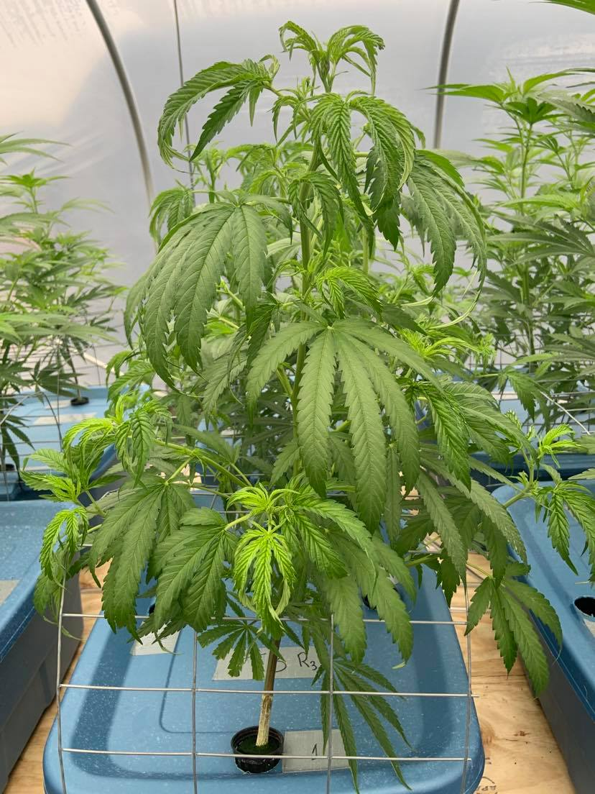
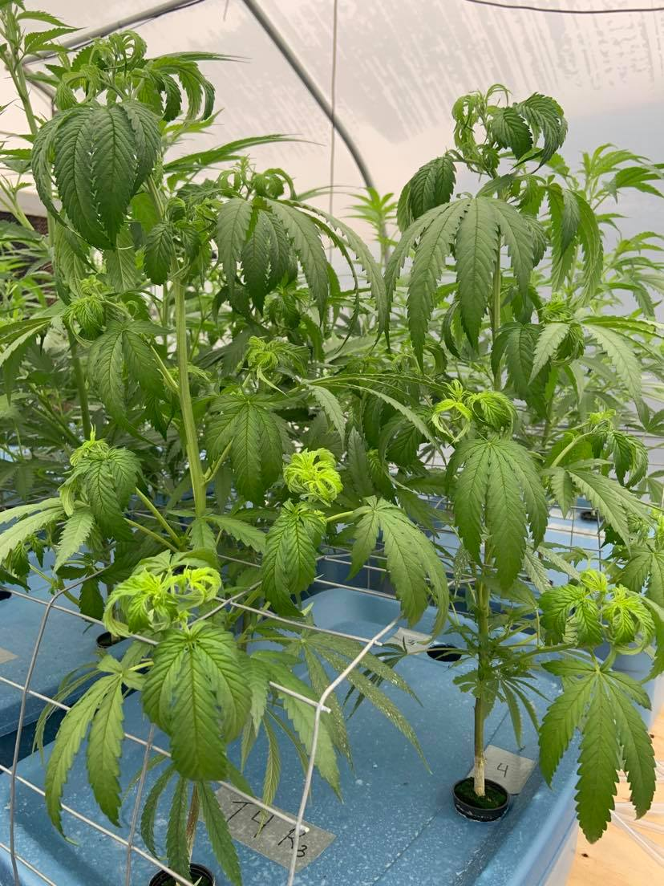
10 ppm Cd
25 ppm Cd
2 DAT

Slide 13
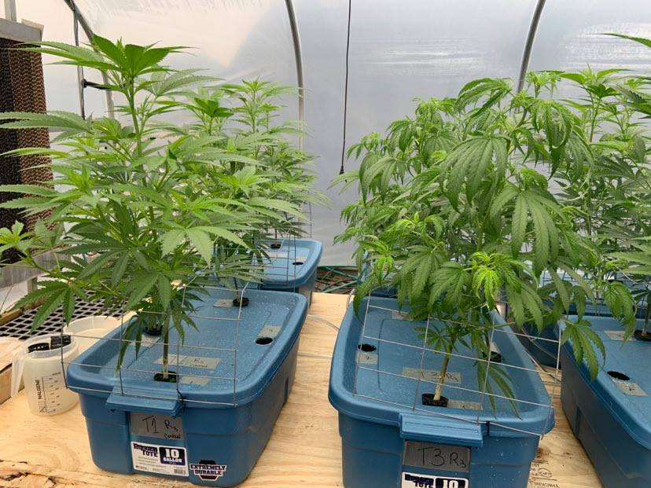
Control
10 ppm Cd
2 DAT

Slide 14
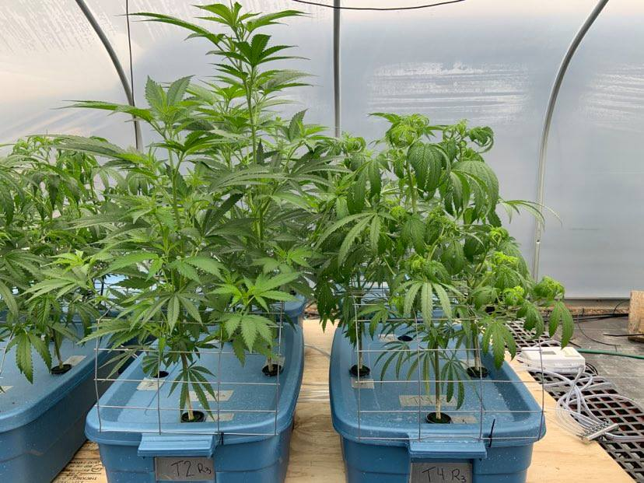
2.5 ppm Cd
25 ppm Cd
2 DAT

Slide 15
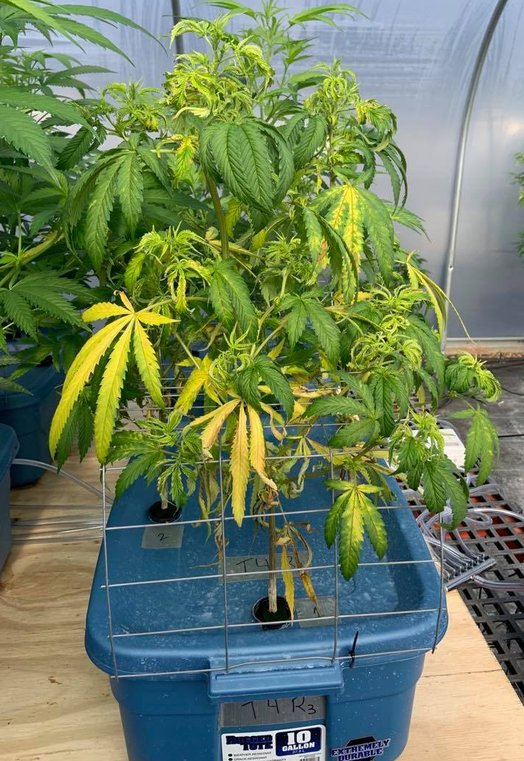
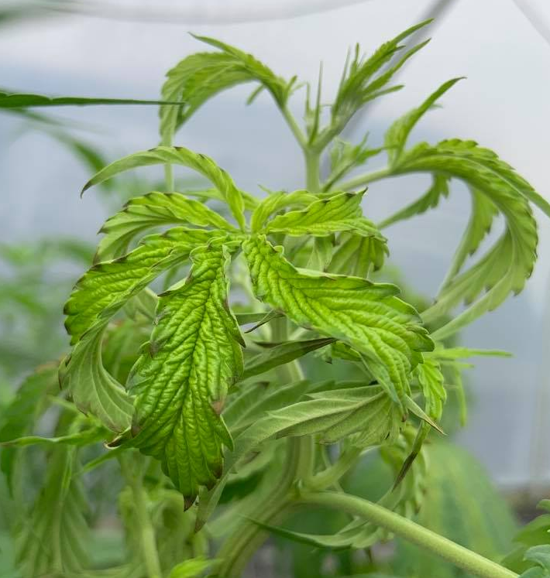
25 ppm Cd
11 DAT

Slide 16
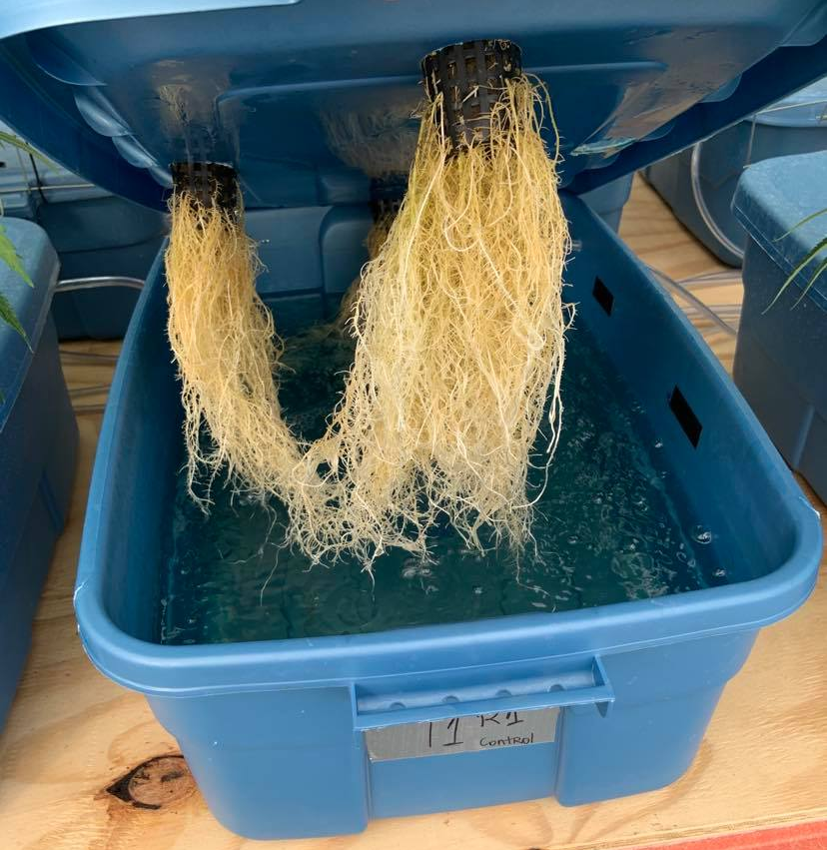
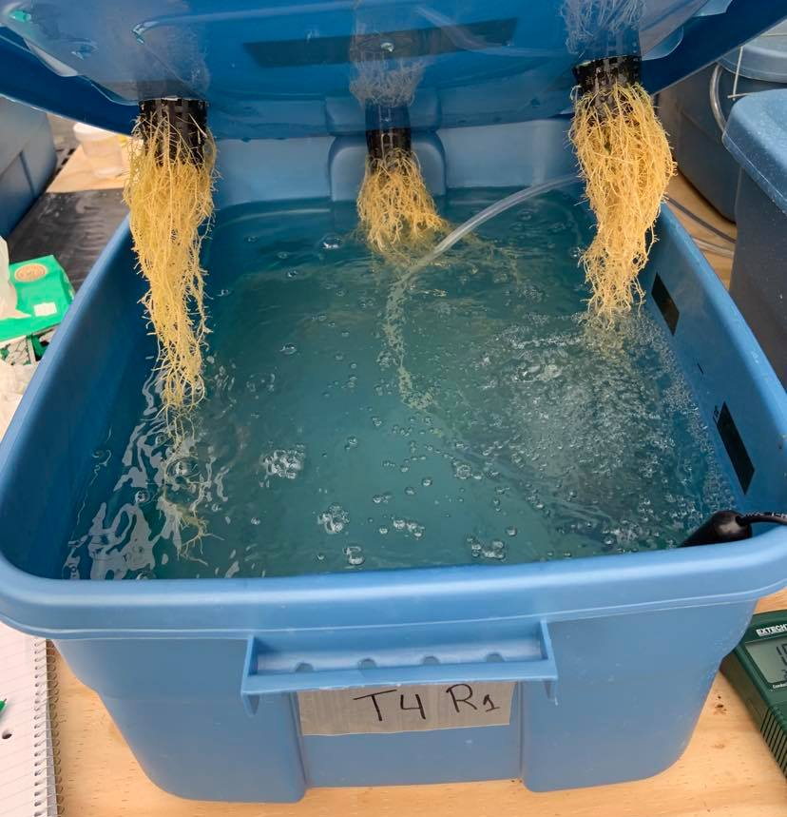
Control
25 ppm Cd
11 DAT

Slide 17
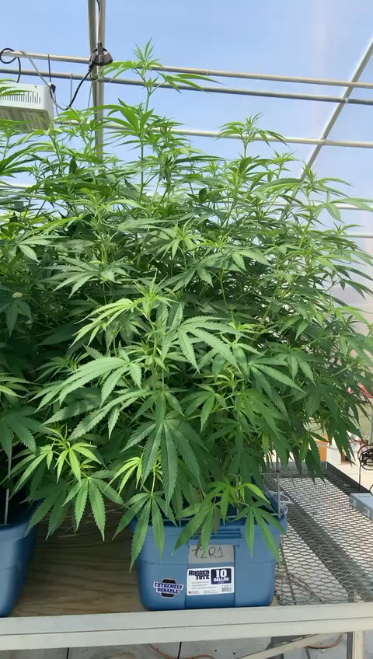
21 DAT

Slide 18
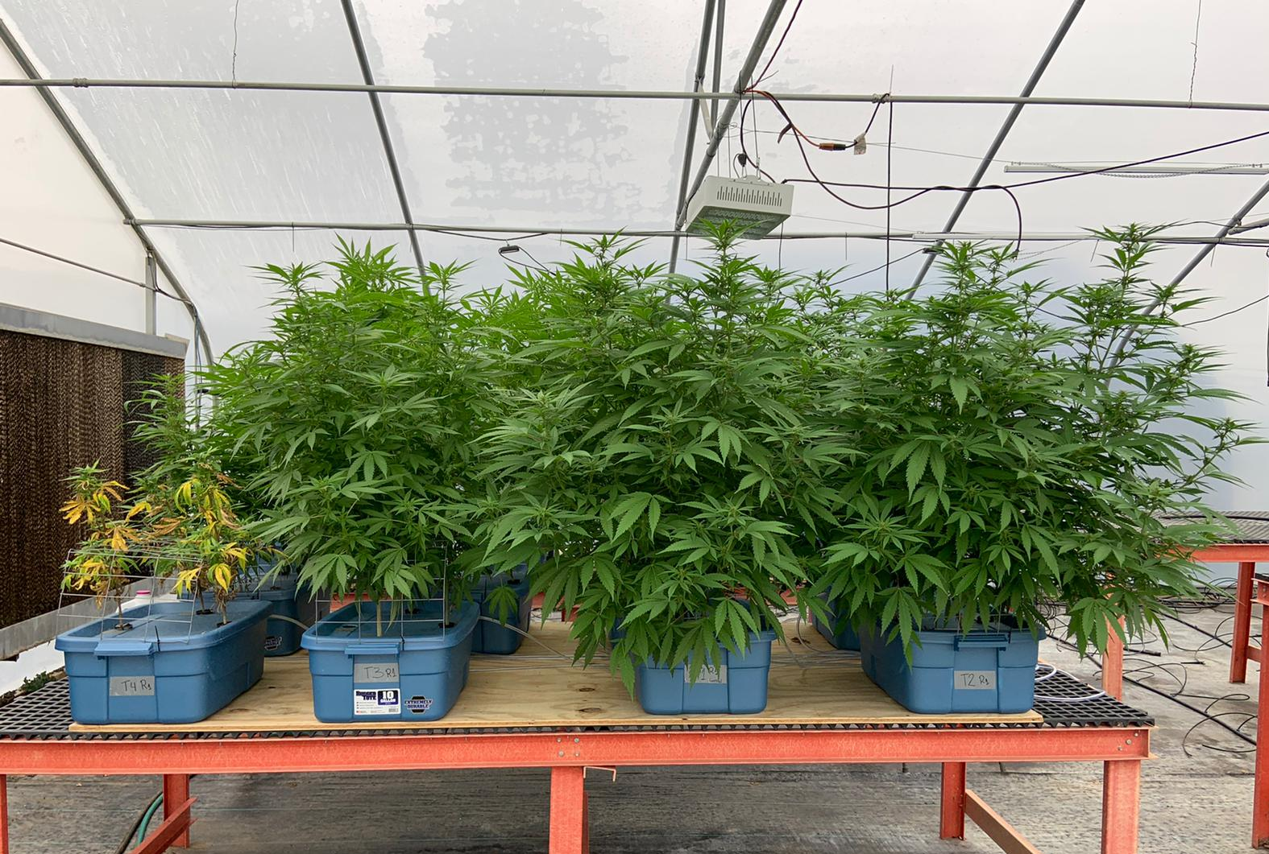
25 ppm Cd
10 ppm Cd
Control
2.5 ppm Cd
30 DAT

Slide 19
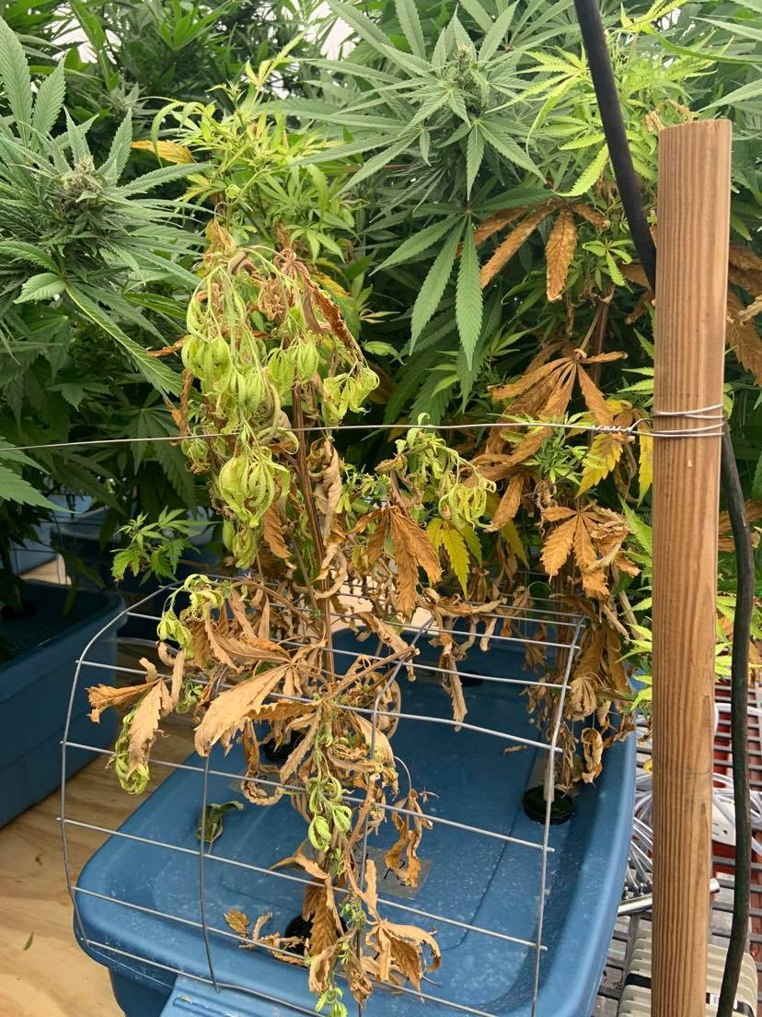
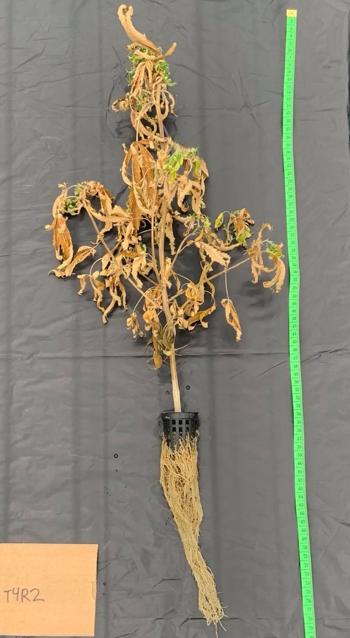
25 ppm Cd
45 DAT

Slide 20
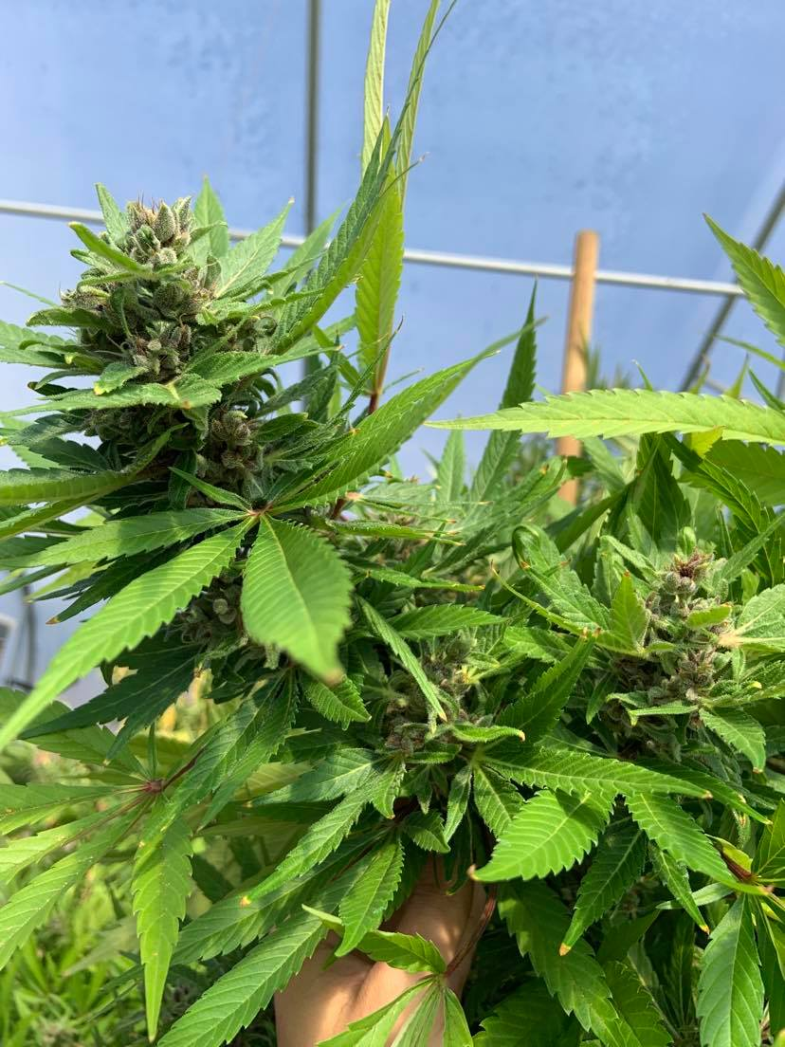
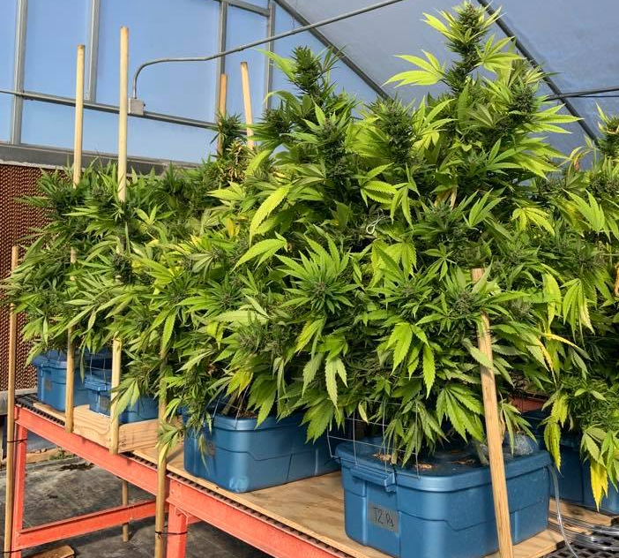
Harvest
68 DAT
8th week of flowering.
Control

Slide 21
Levels not connected by the same letter are significantly different at α = 0.05

Slide 22
Levels not connected by the same letter are significantly different at α = 0.05

Slide 23
Table 3. Average cadmium (Cd) concentration in hemp (Cannabis sativa L.) plant tissues on a dry weight (dw) basis in experiment 1.
 | Cd concentration (mg.kg¯¹)
Treatment | Flower | Roots | Leaves | Stems
Control | 0.1 C | 3.3 C | 0.26 D | 0.1 D
2.5 ppm Cd | 8.73 B | 1628 B | 11.2 C | 15.3 C
10 ppm Cd | 74.7 A | 6146 A | 176.3 B | 147.1 B
25 ppm Cd | NA^{i} | 12663 A | 589.4 A | 1344 A
^{i}NA = not available for sampling due to inability to form floral tissue
Levels not connected by the same letter are significantly different at α = 0.05

Slide 24
Table 4. Average cadmium (Cd) concentration in hemp (Cannabis sativa L.) plant tissues on a dry weight (dw) basis in experiment 2.
Cd concentration (mg.kg¯¹)
Treatment | Flower | Roots | Leaves | Stems
Control | 0.0 C | 4.7 C | <0.05 D | <0.025 D
2.5 ppm Cd | 7.56 B | 1983 B | 13.2 C | 5.12 C
10 ppm Cd | 25.47 A | 4782 A | 38.9 B | 20.67 B
25 ppm Cd | NA^{i} | 7436 A | 382 A | 353.3 A
^{i}NA = not available for sampling due to inability to form floral tissue
Levels not connected by the same letter are significantly different at α = 0.05

Slide 25
A
AB
B
A
A
A
a
a
a
a
ab
b
Levels not connected by the same letter are significantly different at α = 0.05

Slide 26
Conclusions
Our findings indicate the ability of C. sativa to tolerate Cd exposure of 2.5 and 10 ppm Cd in a hydroponic solution.
Concentrations of 25 ppm Cd severely restricted growth, reduced F_{v}/F_{m}, and caused premature death.
As expected, Cd concentration was the highest in the roots, but there were significant concentrations of Cd in leaves, stems, and flowers, with increasing Cd in solution.
Plant biomass and total CBD and THC in flowers were not significantly different between plants in the control treatment and plants exposed to up to 10 ppm Cd.
While Cd availability to plants used in this study is greater than what would be encountered on agricultural soils, our results show that hemp plants have the potential to accumulate Cd in floral tissue. Therefore, heavy metal testing in C. sativa consumer products should be of special concern.

Slide 27
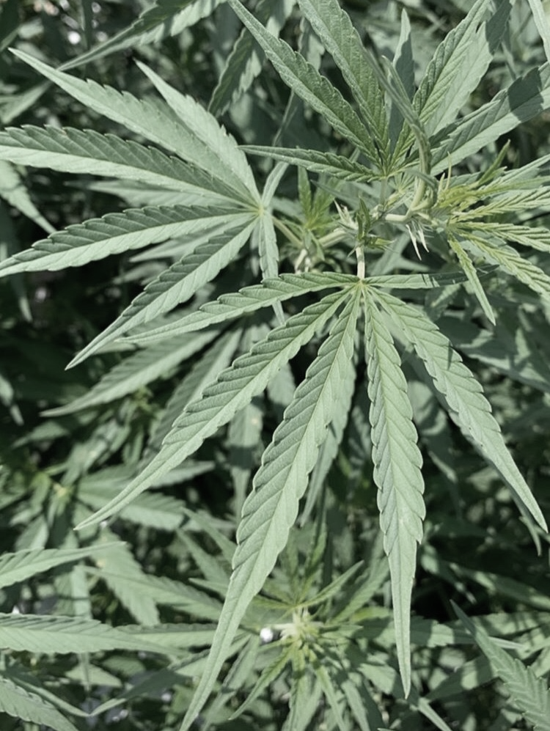
Thank you!
Amanda Olbrick Marabesi
aom@uga.edu
(706) 363-5630

